Slide 1
Mutability Example

Slide 2
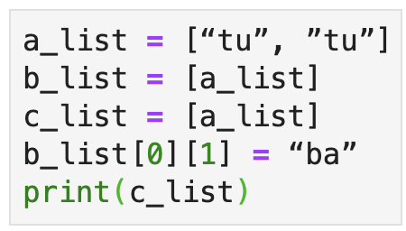
Mutability Example
Name Space
Object Space

Slide 3
Mutability Example

